Slide 1
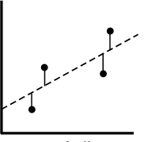
Ordinary Least-Squares
Emmanuel Iarussi Inria

Slide 2
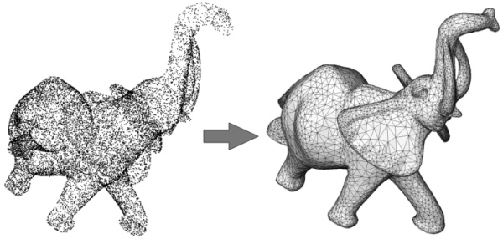
Many graphics problems can be seen as finding the best set of parameters for a model, given some data
Surface reconstruction

Slide 3
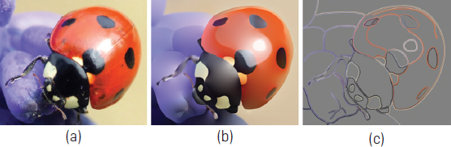
Many graphics problems can be seen as finding the best set of parameters for a model, given some data
Color diffusion

Slide 4
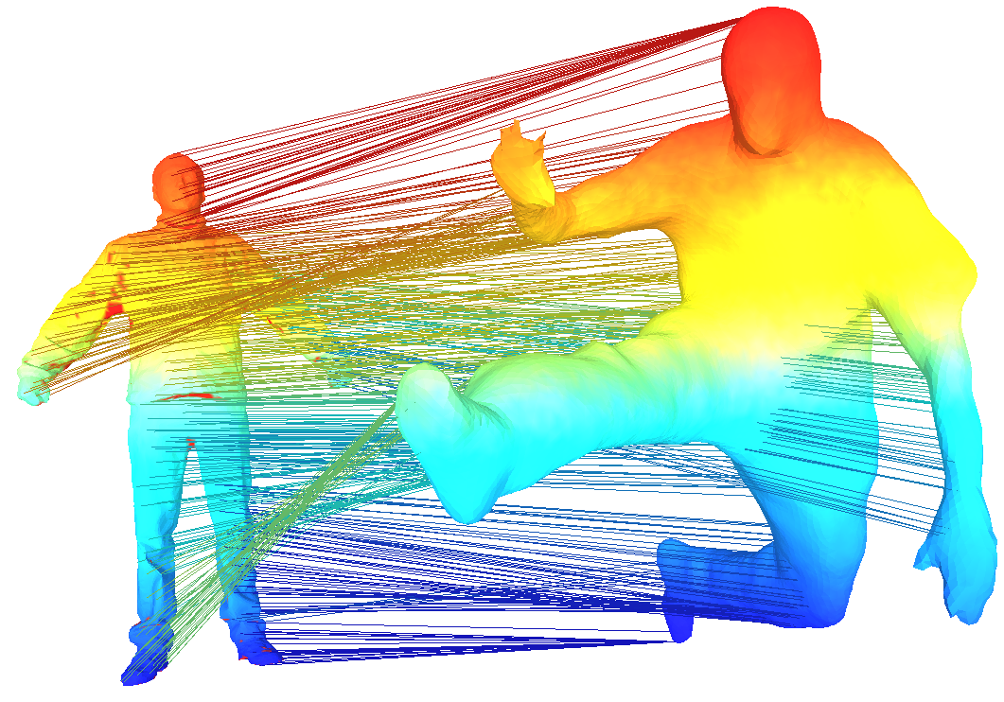
Many graphics problems can be seen as finding the best set of parameters for a model, given some data
Shape registration

Slide 5


Example: estimation of gas pressure for a given temperature sample
Temperature (a)
Gas pressure (b)

Slide 6
Assuming linear relationship

Slide 7
Assuming linear relationship

Slide 8
Assuming linear relationship
Pressure measurements (m)
Temperature measurements (m)

Slide 9
Assuming linear relationship
=
Pressure measurements (m)
Temperature measurements (m)

Slide 10
Assuming linear relationship
=
Pressure measurements (m)
Temperature measurements (m)
The relationship might not be exact

Slide 11
Assuming linear relationship
=
Pressure measurements (m)
Temperature measurements (m)
…
The relationship might not be exact
Match “as best as possible” the observations

Slide 12
Assuming linear relationship
=
Pressure measurements (m)
Temperature measurements (m)
The relationship might not be exact
Match “as best as possible” the observations

Slide 13
or
Many of CG problems can be formulated as minimizing the sum of squares of the residuals between some features in the model and the data.

Slide 14
Matrix notation (observations)
We can rewrite the residual function using linear algebra as:

Slide 15

Example: estimation of gas pressure for a given temperature and altitude samples
Temperature
Gas pressure
Altitude

Slide 16
Multidimensional linear regression, using a model with n parameters

Slide 17
Multidimensional linear regression, using a model with n parameters
+ +…
before

Slide 18
Multidimensional linear regression, using a model with n parameters
Pressure measurements (m)
Temperature measurements (m)
Altitude
measurements (m)

Slide 19
Multidimensional linear regression, using a model with n parameters
=
Pressure measurements (m)
Temperature measurements (m)
Altitude
measurements (m)

Slide 20
=

Slide 21
=

Slide 22
=

Slide 23
Objective: find x subject to minimize:

Slide 24
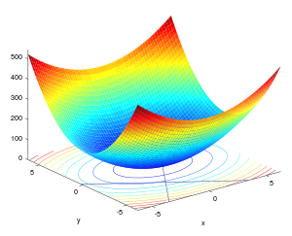
Objective: find x subject to minimize:

Slide 25
Objective: find x subject to minimize:
Convex bowl function has minima when:

Slide 26
Objective: find x subject to minimize:
Convex bowl function has minima when:
gradient

Slide 27
Expanding square term

Slide 28
Expanding square term

Slide 29
Expanding square term
Differentiating with respect to x (gradient)

Slide 30
Expanding square term
Differentiating with respect to x (gradient)

Slide 31
Expanding square term
Differentiating with respect to x (gradient)
Normal
equation
x = (A.transpose()*A).solve(A.transpose()*b);

Slide 32
Expanding square term
Differentiating with respect to x (gradient)
Normal
equation
x = (A.transpose()*A).solve(A.transpose()*b);
Issue: matrix multiplication

Slide 33
Expanding square term
Differentiating with respect to x
Normal
equation
x = (A.transpose()*A).solve(A.transpose()*b);
Issue: matrix multiplication
Solution: find expression

Slide 34
Let's go back to gradient = 0

Slide 35
Let's go back to gradient = 0
Differentiating again with respect to x

Slide 36
Let's go back to gradient = 0
Differentiating again with respect to x

Slide 37
Let's go back to gradient = 0
Differentiating again with respect to x
hessian

Slide 38
Let's go back to gradient = 0
Differentiating again with respect to x
hessian

Slide 39
Let's go back to gradient = 0
Differentiating again with respect to x
Normal equation:
x = (A.transpose()*A).solve(A.transpose()*b);

Slide 40
Let's go back to gradient = 0
Differentiating again with respect to x
Normal equation:
x = (A.transpose()*A).solve(A.transpose()*b);

Slide 41
Let's go back to gradient = 0
Differentiating again with respect to x
Two alternatives for solving:
x = (A.transpose()*A).solve(A.transpose()*b);
x = (H).solve(c);
Constant terms in gradient

Slide 42
Example: Diffusion

Slide 43
Example: Diffusion
Minimize difference between neighbors
…

Slide 44
Example: Diffusion
Minimize difference between neighbors
…

Slide 45
Example: Diffusion
Minimize difference between neighbors
…

Slide 46
Example: Diffusion
Minimize difference between neighbors
…

Slide 47
Solving with normal equation:
Build A
…

Slide 48
Solving with normal equation:
Build A
…

Slide 49
Solving with normal equation:
Build A
…

Slide 50
Solving with normal equation:
Build A
…

Slide 51
Solving with normal equation:
Build A
…

Slide 52
Solving with normal equation:
Build A
…

Slide 53
Solving with normal equation:
2. Compute and

Slide 54
Solving with normal equation:
Solve using:
Cholesky decomposition
Conjugate Gradient
…
in Eigen (i.e):
x = (A.transpose()*A).solve(A.transpose()*b);

Slide 55
Solving with normal equation:
Solve using:
Cholesky decomposition
Conjugate Gradient
…
in Eigen (i.e):
x = (A.transpose()*A).solve(A.transpose()*b);
x wil have:

Slide 56
Solving with Hessian:
1. Gradient vector: first-order partial derivatives of energy terms

Slide 57
Solving with Hessian:
1. Gradient vector: first-order partial derivatives of energy terms

Slide 58
Solving with Hessian:
1. Gradient vector: first-order partial derivatives of energy terms

Slide 59
Solving with Hessian:
1. Gradient vector: first-order partial derivatives of energy terms

Slide 60
Solving with Hessian:
1. Gradient vector: first-order partial derivatives of energy terms

Slide 61
Solving with Hessian:
2. Hessian matrix: second-order partial derivatives of energy terms

Slide 62
Solving with Hessian:
2. Hessian matrix: second-order partial derivatives of energy terms

Slide 63
Solving with Hessian:
2. Hessian matrix: second-order partial derivatives of energy terms

Slide 64
Solving with Hessian:
2. Hessian matrix: second-order partial derivatives of energy terms

Slide 65
Solving with Hessian:

Slide 66
Solving with Hessian:
1. Gradient vector: first-order partial derivatives of energy terms

Slide 67
Solving with Hessian:
1. Gradient vector: first-order partial derivatives of energy terms

Slide 68
Solving with Hessian:
1. Gradient vector: first-order partial derivatives of energy terms

Slide 69
Solving with Hessian:
1. Gradient vector: first-order partial derivatives of energy terms

Slide 70
Solving with Hessian:
2. Hessian matrix: second-order partial derivatives of energy terms

Slide 71
Solving with Hessian:
2. Hessian matrix: second-order partial derivatives of energy terms

Slide 72
Solving with Hessian:
2. Hessian matrix: second-order partial derivatives of energy terms

Slide 73
Solving with Hessian:
2. Hessian matrix: second-order partial derivatives of energy terms

Slide 74
Solving with Hessian:

Slide 75
Solving with Hessian:
To recap:

Slide 76
Solving with Hessian:
3. Build system
…

Slide 77
Solving with Hessian:
3. Build system
…

Slide 78
Solving with Hessian:
3. Build system: add constraint
…

Slide 79
Solving with Hessian:
3. Build system: add constraint
…

Slide 80
Solving with Hessian:
3. Build system: add constraint
…

Slide 81
Solving with Hessian:
3. Build system: add constraint
…

Slide 82
Solving with Hessian:
3. Build system: add constraint
…

Slide 83
Solving with Hessian:
3. Build system: add constraint
…

Slide 84
Solving with Hessian:
3. Build system: add constraint
…

Slide 85
Solving with Hessian:
3. Build system: add constraint
…

Slide 86
Solving with Hessian:
3. Build system: add constraint
…

Slide 87
Solving with Hessian:
Solving with Hessian:
4. Solve using:
Cholesky decomposition
Conjugate Gradient
…

Slide 88
Solving with Hessian:
Solving with Hessian:
4. Solve using:
Cholesky decomposition
Conjugate Gradient
…
in Eigen (i.e):
x = (H).solve(b`);
x will have:

Slide 89
References:
Solving Least Squares Problems. C. L. Lawson and R. J. Hanson. 1974.
Practical Least Squares for Computer Graphics. Fred Pighin and J.P. Lewis. Course notes 2007.

